Slide 1

Adopt an Oyster
Pitch for Billion Oyster Project (Team 3)
Notes:
When presenting: improve body language and better transitions between people and speak clearer. Take off full sentences from powerpoint so we are not really off the slides (put a title and then explain it or just pictures).

Slide 2
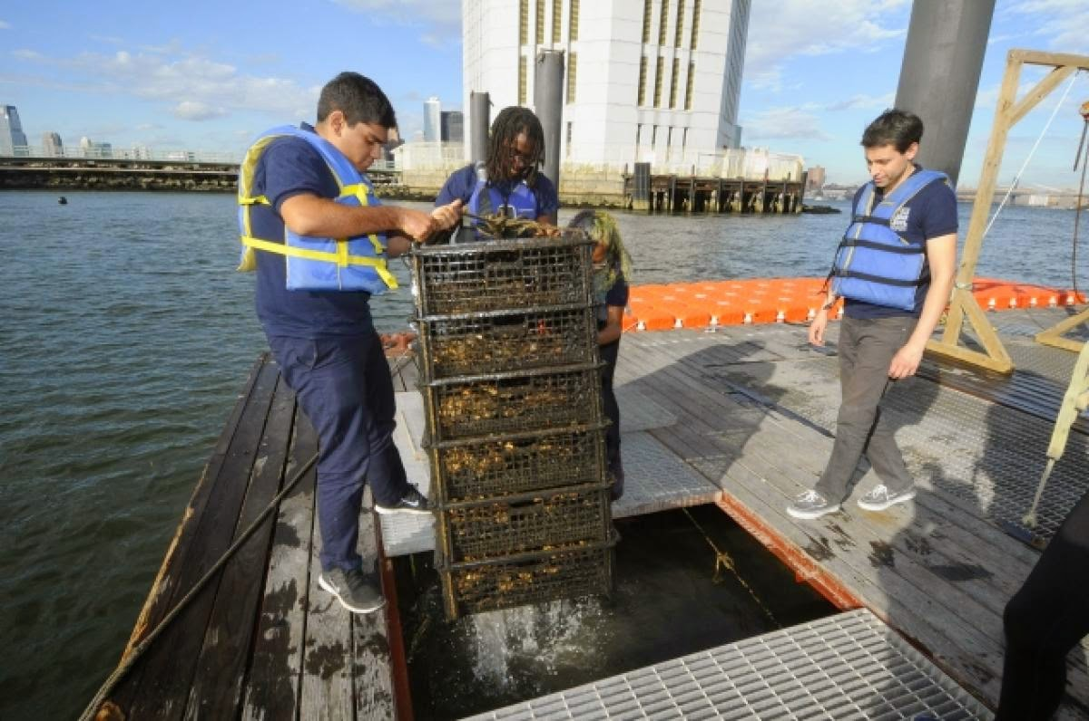
Adopt an Oyster
People will be able to visit website to adopt and customize their oyster adoption.
Similar to Adopt-a-Highway.

Slide 3
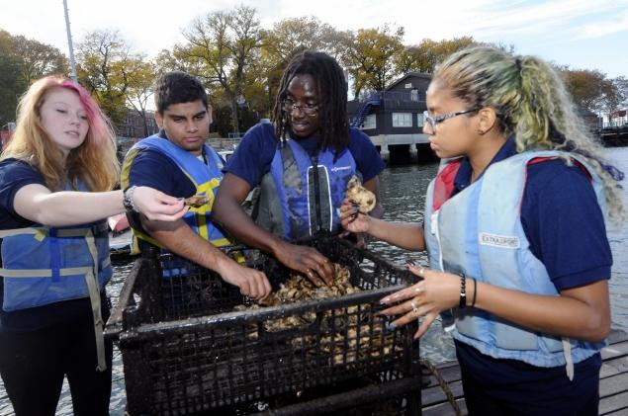
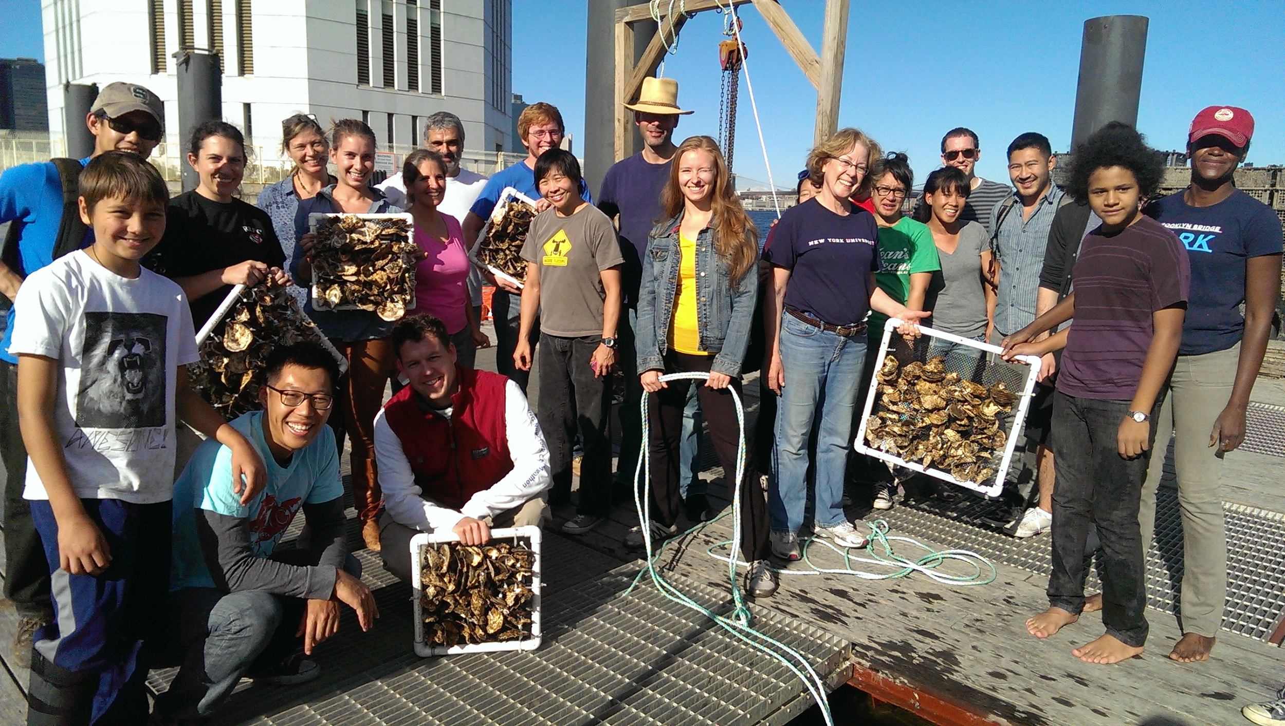
Goals
Only people involved in project are middle-schoolers.
Website designed to get more involved.
Attempt to interest teens and adults.

Slide 4
Website
The website would include many facts concerning the purpose, importance and benefits of the Billion Oyster Project.
It would contain an avenue for customized adoption for interested parties.

Slide 5
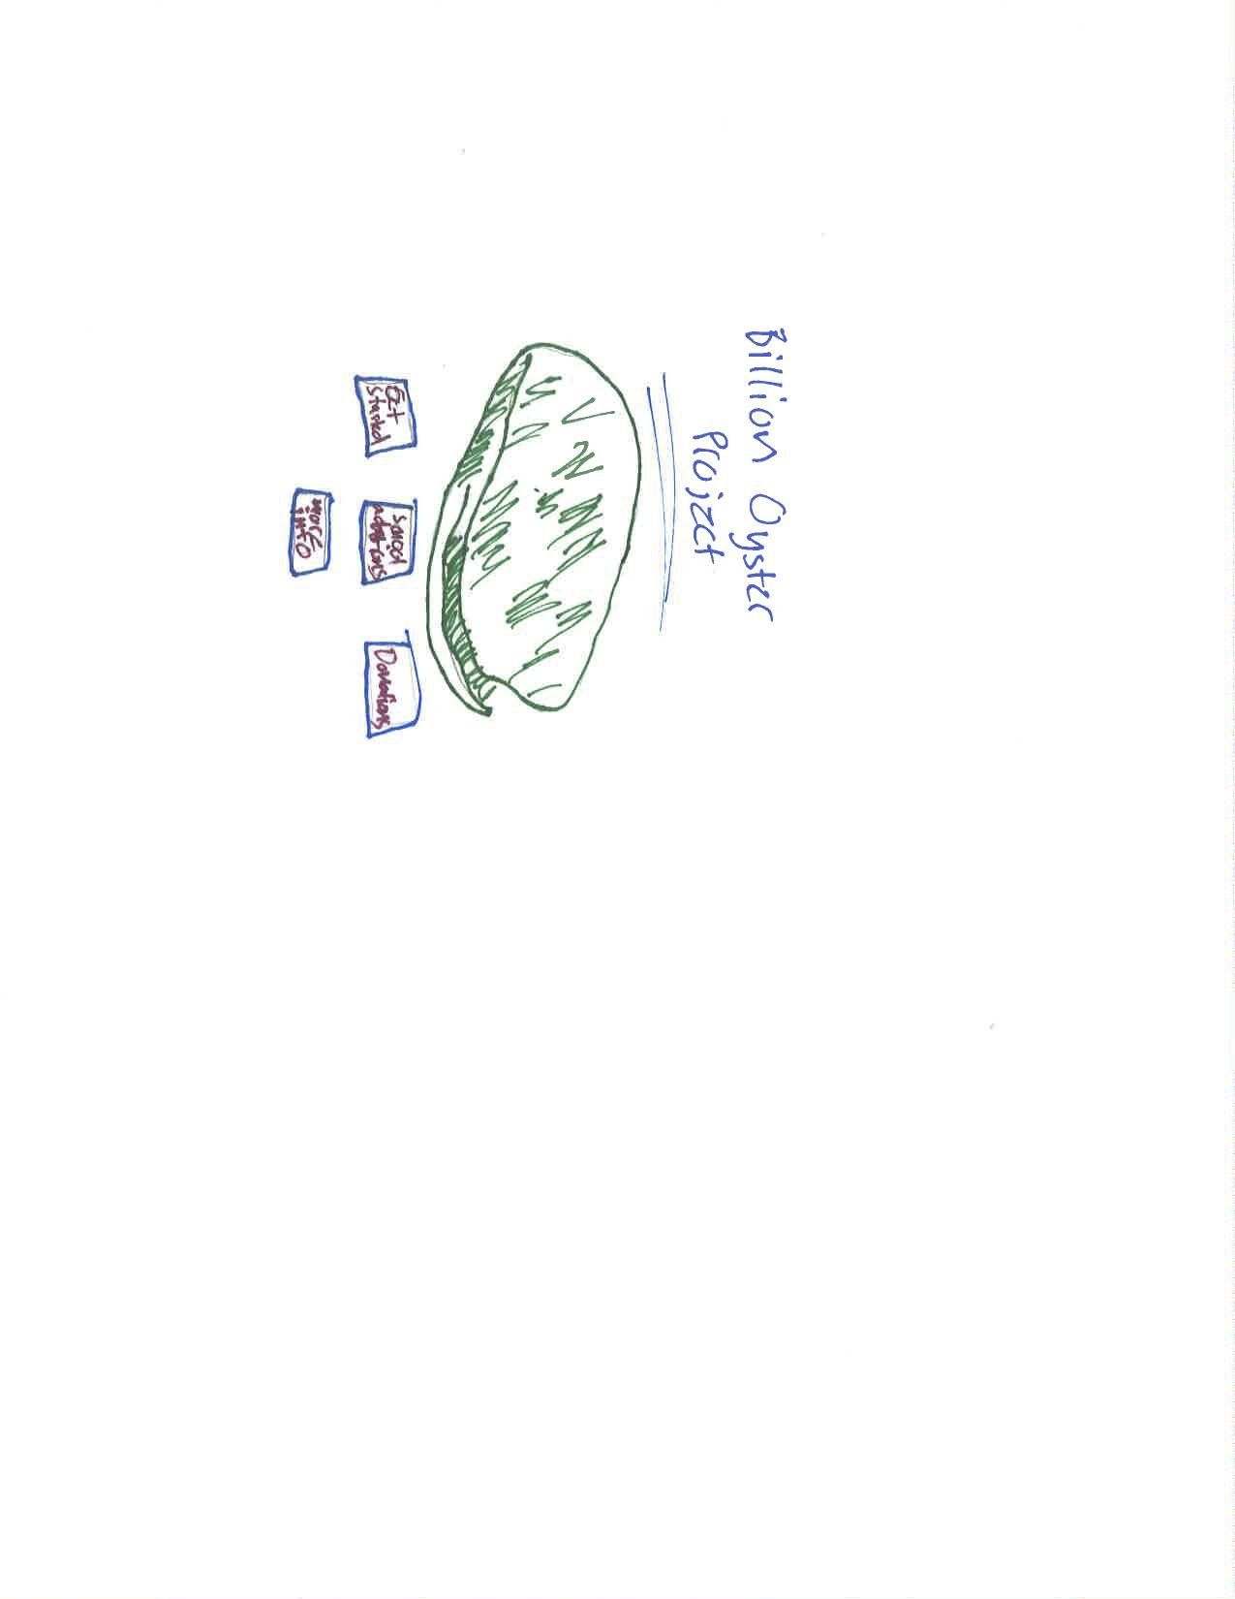
The Website Layout

Slide 6
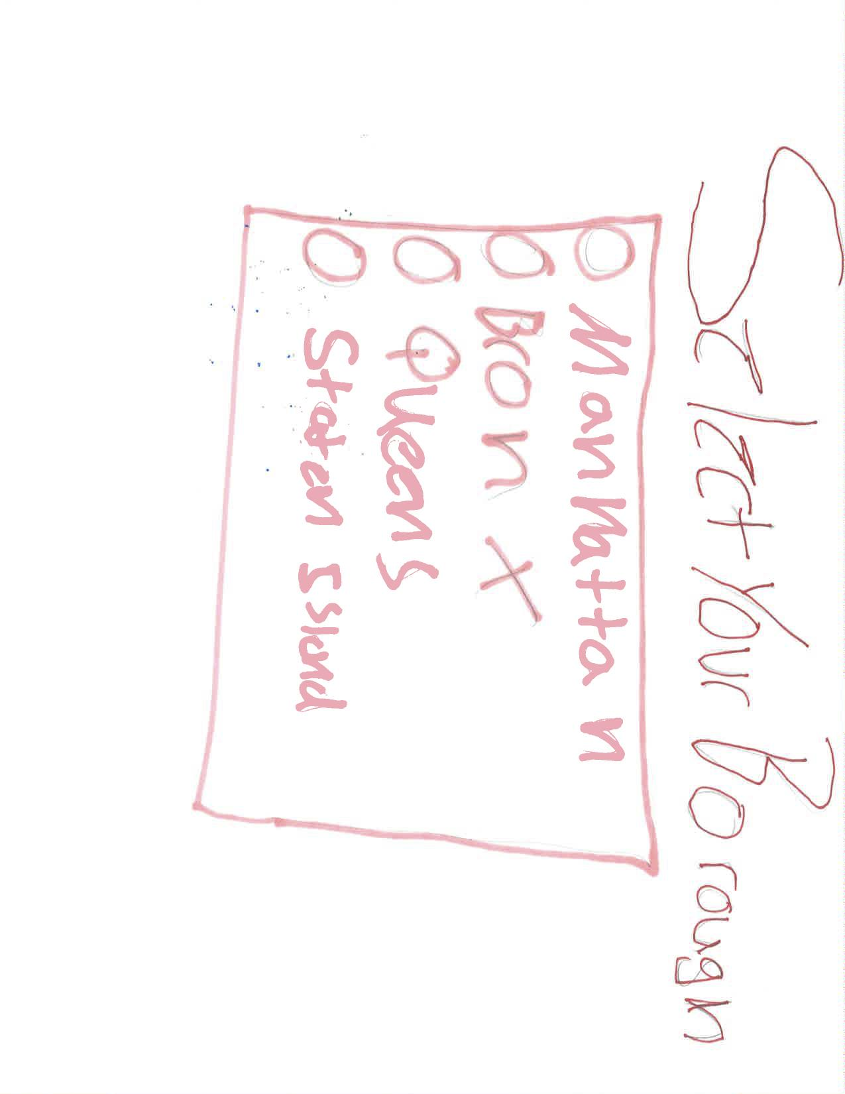
⃝ Brooklyn

Slide 7
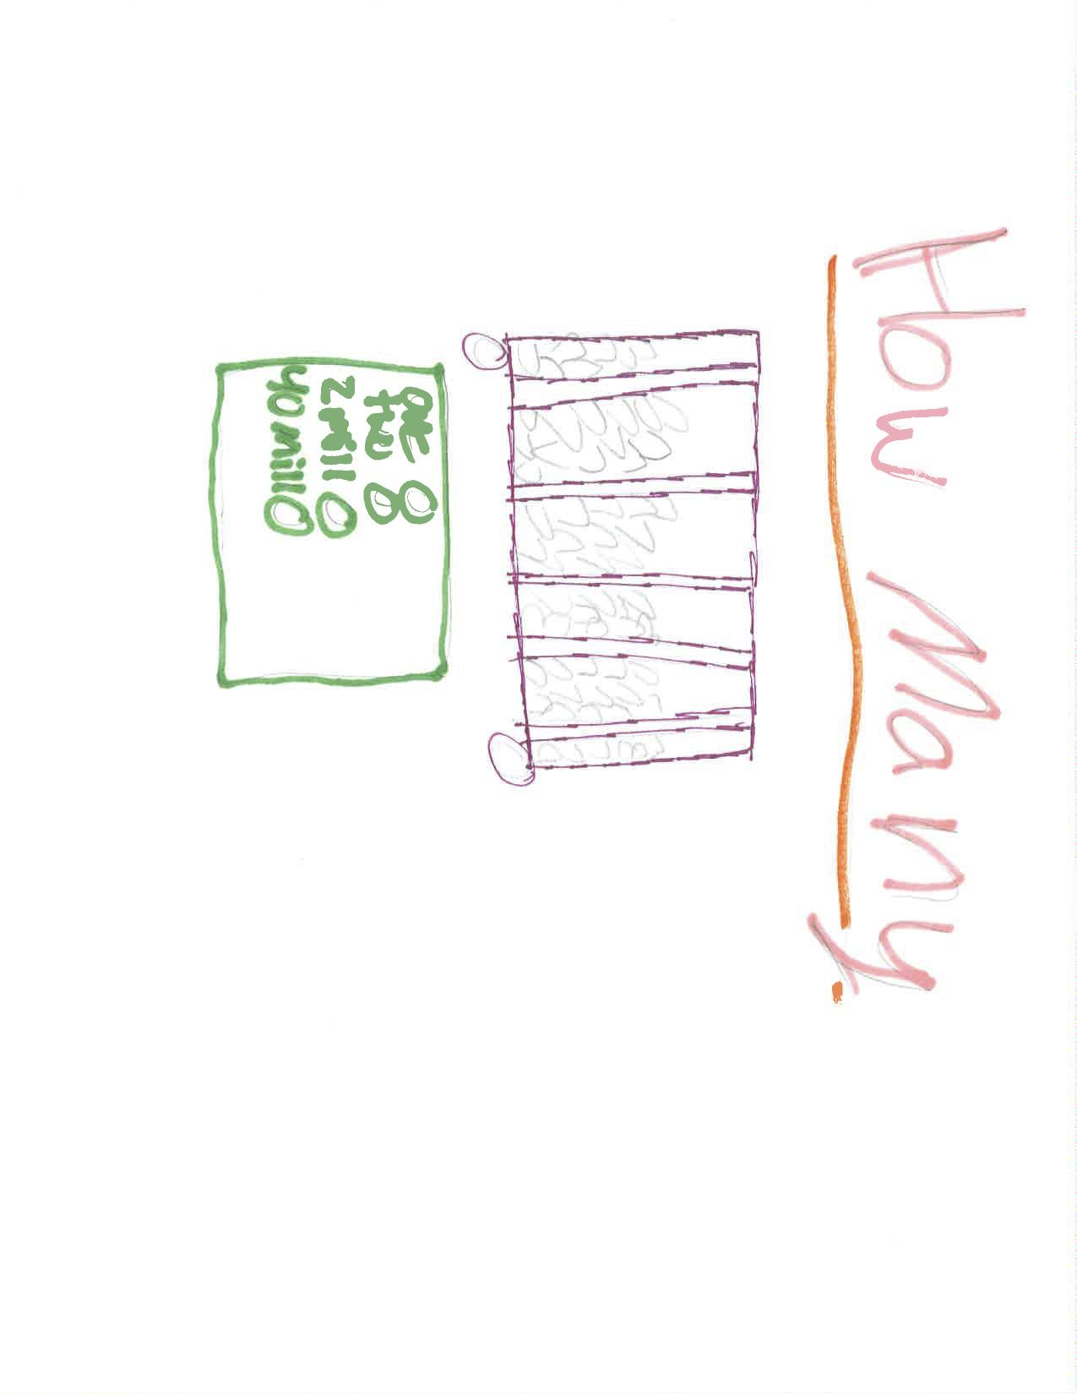

Slide 8
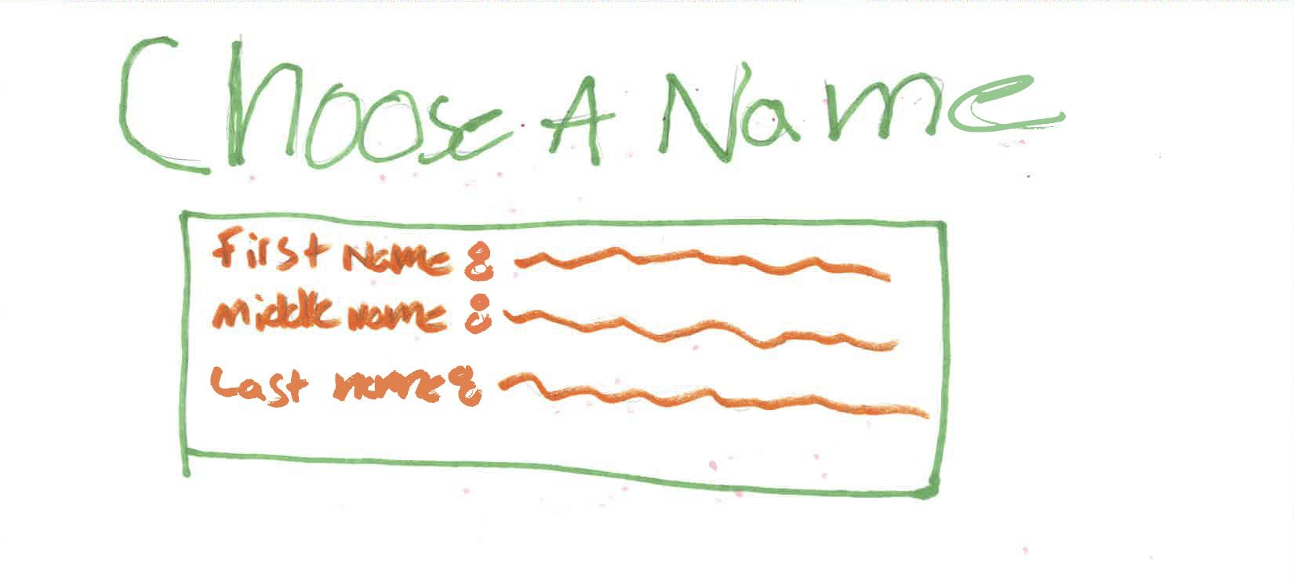

Slide 9
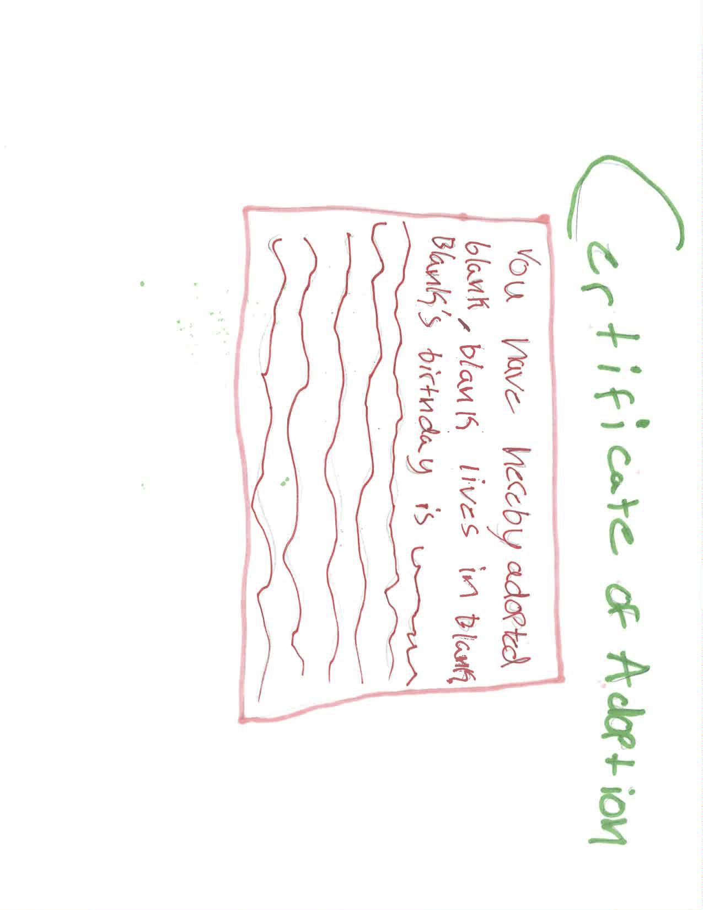

Slide 10
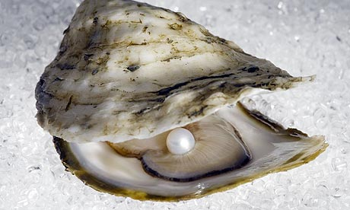
THANK YOU!!!!

